Slide 1


Laptop Sales Data Analysis
P. Rahul Nikshai
24-07-2025
DA&DS & May’25

Slide 2

CONTENTS
1. Introduction
2. Data Understanding
3. Data Cleaning
4. Handling missing values
5. EDA (Exploratory Data Analysis)
Univariant Analysis
Bivariant Analysis
Multivariant Analysis
6. Insights and Recommendation
7. Conclusion

Slide 3


Introduction
This project uses Python tools to explore a dataset related to laptop specifications and sales. The goal is to clean, analyze, and visualize the data to identify trends and insights that can help businesses make smarter inventory and marketing decisions.

Slide 4




Workflow Summary
1
2
3
4
5
Import dataset
Clean data
Add useful metrics
Apply statistical and visual analysis
Extract business insights and give recommendations

Slide 5

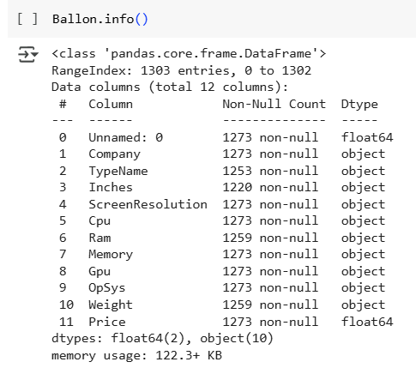
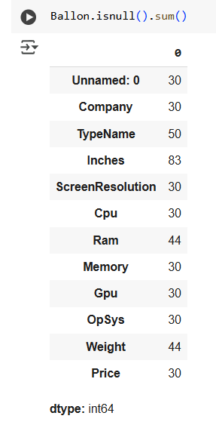
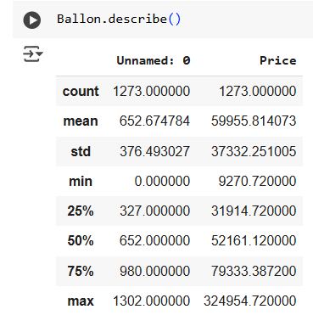
Data Understanding
The dataset has details about laptops like brand, type, RAM, screen size, weight, and price.We used Python (pandas) to load the data and found some missing values and an extra column, which we removed. Some data like RAM and Inches were in the wrong format, so we fixed them. This helped us get the data ready for analysis.

Slide 6

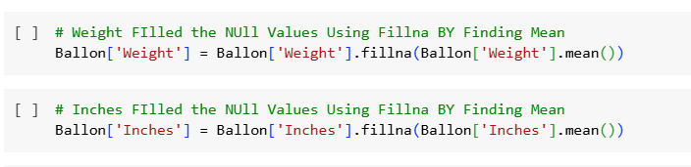
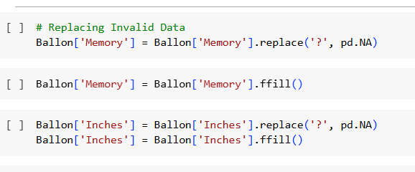
DATA CLEANING
Handling missing values | Address Inconsistencies

Slide 7
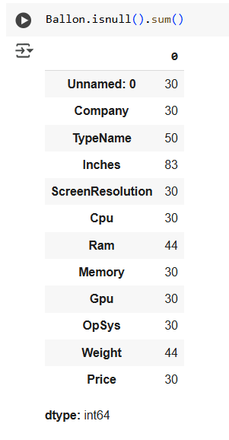
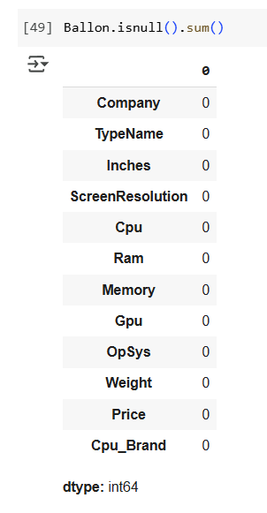
HANDLING MISSING VALUES
BEFORE HANDLING | AFTER HANDLING
Checked for null/missing values in critical columns.
Methods Used:
Mean/median imputation for numerical values
Mode for categorical variables
Row removal where data was not recoverable

Slide 8
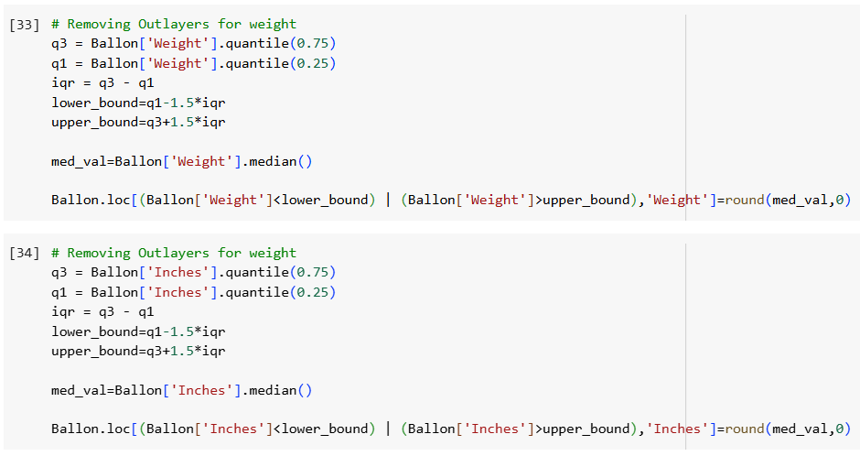
OUTLIER HANDLING
Extreme values in numeric fields like Price or Weight can distort analysis. Visual inspection using box plots or value counts helped identify and understand outliers. Based on domain knowledge and visual analysis, extreme or unrealistic entries were noted, though not all were removed if they were valid.

Slide 9
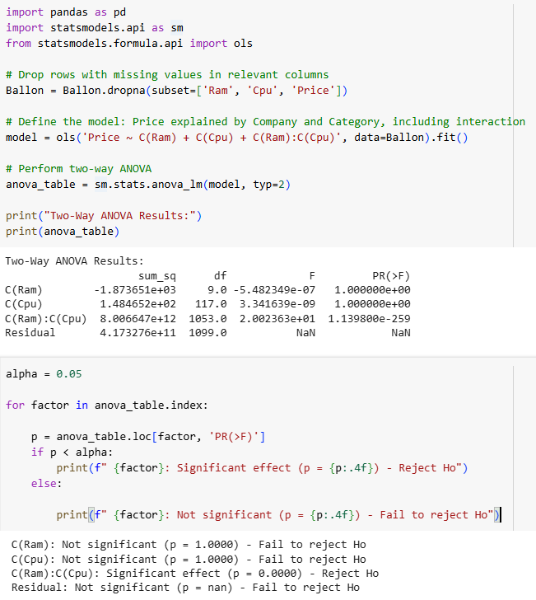
STATISTICAL ANALYSIS
Used descriptive stats and hypothesis tests (t-tests, chi-square) to validate relationships, such as accessories affecting pricing and brand-preference trends.

Slide 10

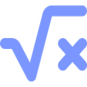

EDA Breakdown
Univariate
Bivariate
Multivariate
Examined individual features with histograms and bar charts
Explored pairs of variables like RAM vs price
Analyzed multiple variables using catplots and correlation heatmaps

Slide 11
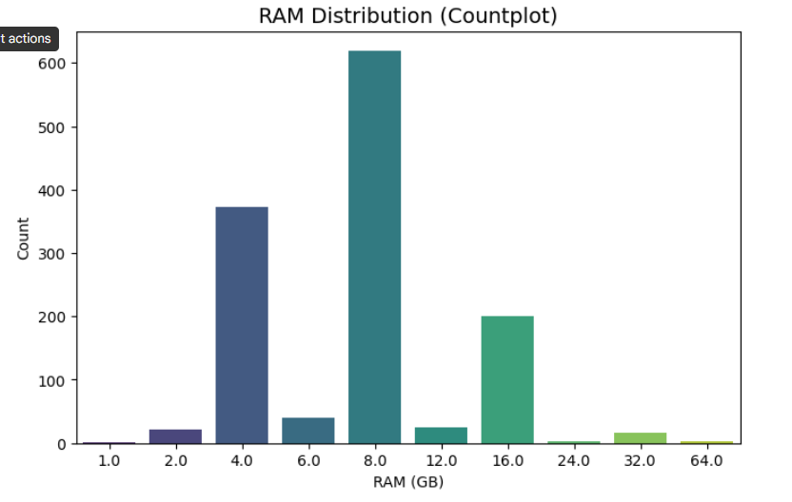
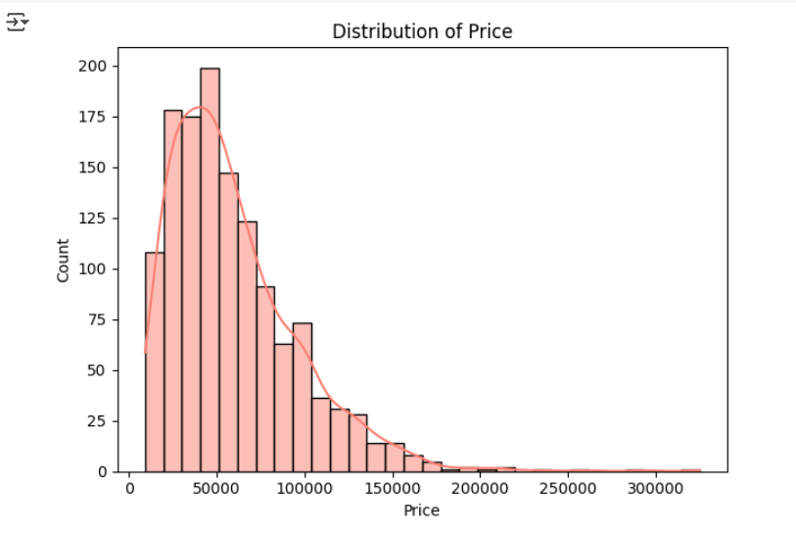
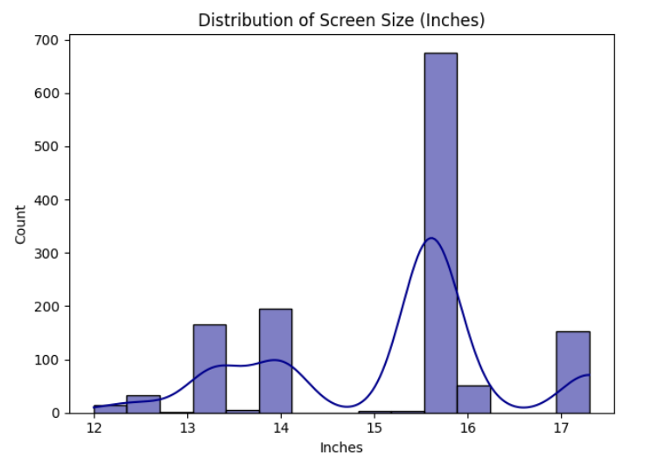
UNIVARIENT ANALYSIS

Slide 12
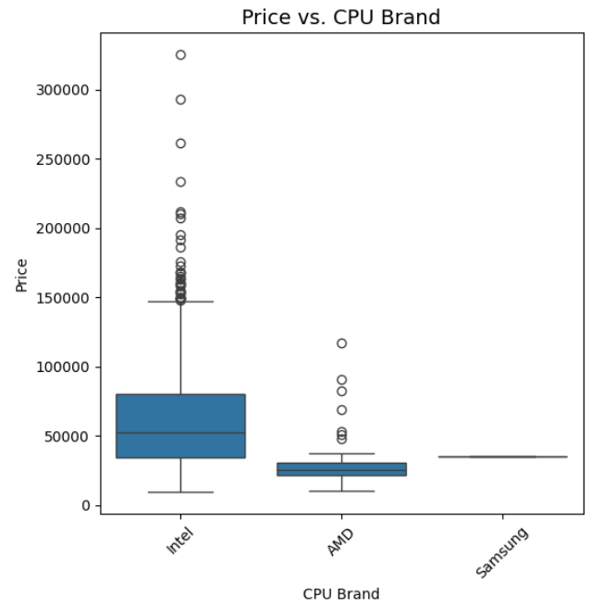
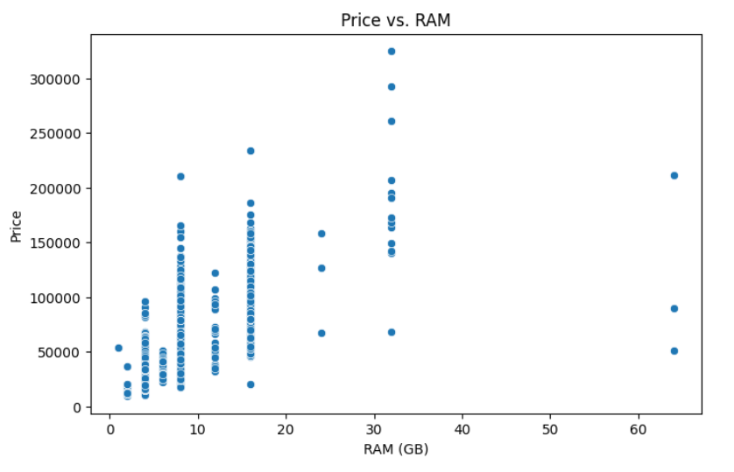
BIVARIENT ANALYSIS

Slide 13
BIVARIENT ANALYSIS

Slide 14
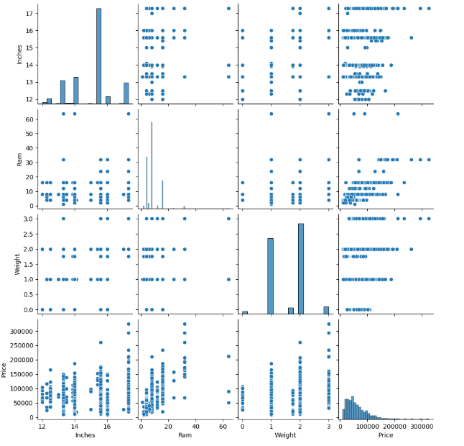
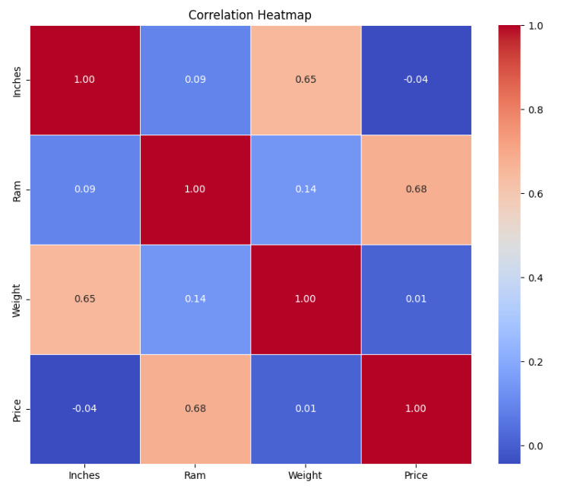
MULTIVARIENT ANALYSIS

Slide 15
INSIGHTS AND RECOMMENDATION
INSIGHTS
1. Price: Most laptops are mid-range; high-end models are fewer and brand-driven.
2.Type: Gaming laptops are costliest; Notebooks and Ultrabook's are more common and affordable.
3.Brand Impact: Premium brands (e.g., Apple, MSI) charge more for similar specs.
RECOMMENDATION
1. Offer complementary items like:
Free keyboard and mouse
Optional upgrade to SSD storage
2. These extras increase perceived value, encouraging more purchases without raising the laptop price.

Slide 16

Conclusion
EDA provided valuable insights to improve laptop sales through smarter pricing, bundling, and inventory strategies. Python proved effective in turning raw data into actionable business understanding.

Slide 17

Thank You

